Slide 1
A 2D Numerical Simulation of Atmospheric Convection with Condensation of Major Component Under Early Mars Condition
Tatsuya YAMASHITA¹, Masatsugu ODAKA¹, Ko-Ichiro SUGIYAMA², Kensuke NAKAJIMA³, Masaki ISHIWATARI¹, Yoshi-Yuki HAYASHI⁴
odakker@gfd-dennou.org
¹ Hokkaido University, Japan, ² Institute of Space and Astronautical Science, Japan, ³ Kyushu University, Japan, ⁴ Kobe University, Japan

Slide 2
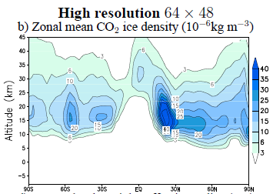
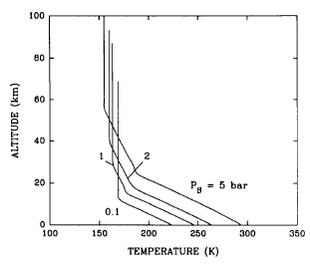
Warm climate and CO₂ ice cloud in Early Mars
Major atmospheric component, CO₂, condenses, and the ice clouds are widely distributed.
In Early Martian climate study, stratiform cloud is assumed.
The nature of convective CO₂ cloud is not studied well.
Temprature by 1D model (kasting 1991)
CO2 cloud distribution by GCM (Forget et al. 2013)
(km)
100
80
60
40
20
0
(km)
40
20
0
Deep CO₂ saturation layer
CO₂ cloud exists wide region
0 200 300 (K)
90S EQ 90N

Slide 3
Condensation convection of CO₂ and cloud type (Colaprete et al. 2003)
Whether supersaturation is allowed or not is key point.
No: Stratiform cloud Yes: Convective cloud
However, circulation features and cloud distribution due to condesation convection of CO₂ are not examined.
Results of Colaprete et al.(2003) is based on 1D cloud model.
Tsat
Can’t obtain buoyancy
Can obtain buoyancy
Tsat
×
P
Tcond (=Tmean)
P
Tcond
Tmean
Air parcel
Air parcel
T
T

Slide 4
The purpose of this study
We investigate circulation features and cloud distribution associated with condensation convection of CO₂ under Early Mars condition
Use 2D cloud resolving numerical model, implemented CO₂ ice cloud physics considering supersaturation
Perform long-term numerical simulations until statistical equilibrium states are reached.
In this presentation…
We show dependencies of critical saturation ratio(Scr) on the circulation features and cloud distribution.
Scr is the saturation ratio for the onset of condensation.

Slide 5
Outline of numerical model
Dynamics: 2D Quasi-compressible fluid
Pure CO₂ atmosphere and its condensation is considered
CO₂ ice cloud microphysics (Tobie et al. 2003)
Diffusional growth, gravitational settling of cloud particles
Number density of condensation nuclei is constant
Radiation
Only IR is considered, given as a horizontal uniform cooling
Surface flux (Louis, 1979)
Estimated from bulk formula with fixed surface temperature
Subgrid scale turbulence (Klemp and Wilhelmson, 1978)
Turbulent flux is calculated by using urbulent kinetic energy.

Slide 6
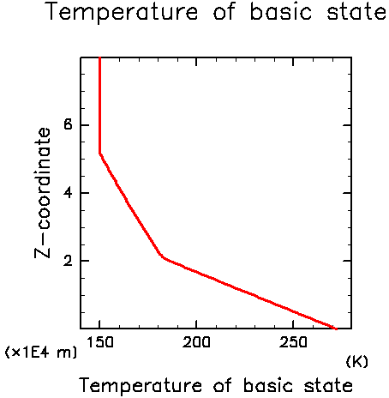
Setup of experiments
Domain size:
100km in horizontal direction (grid spacing: 500m)
80km in vertical direction (grid spacing: 400m)
Initial temperature and cooling profile
Based on Kasting (1991)
Critical saturation ratio (Scr): 1.0, 1.35 (Glandorf et al., 2002)
Number density of condensation nuclei (N*): 5.0x10⁴, 5.0x10⁶, 5.0x10⁸ /kg (Tobie et al.,2003: Forget et al., 2013)
Initial temperature and
cooling profile
(x10 km)
Iso-thermal
Newtonian cooling
Saturation vapor pressure
Uniform cooling
(-0.1 K/day)
Dry adiabat
Ts = 273K Ps = 2.0x10⁵ Pa

Slide 7
Results

Slide 8
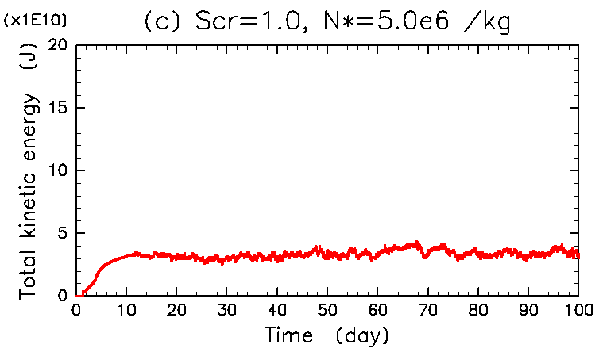
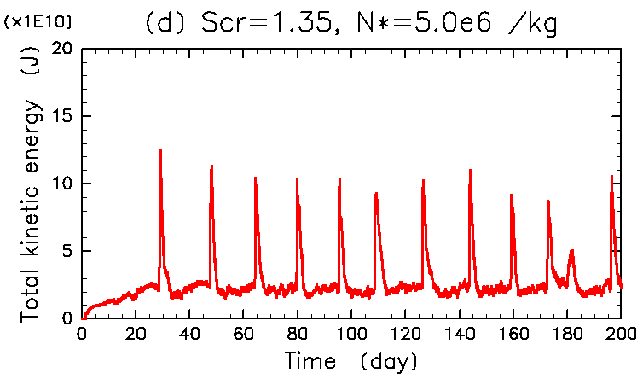
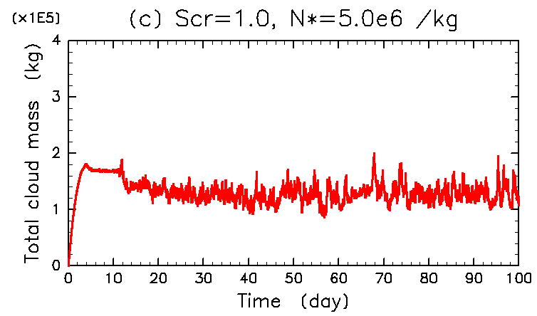
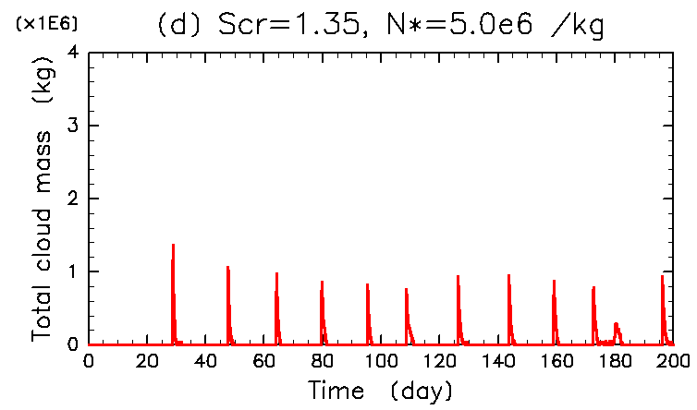
Total kinetic enregy and cloud mass
(x10¹⁰J)
20
10
0
Scr = 1.0
(x10¹⁰J)
20
10
0
Scr = 1.35
Ke
0 20 40 60 80 (day)
0 40 80 120 160 (day)
(x10⁵Kg)
4
2
0
(x10⁶Kg)
4
2
0
Cloud mass
0 20 40 60 80 (day)
0 40 80 120 160 (day)
Total energy and cloud mass are quasi-steady
non-condensation and condensation periods occur alternately
Notes:
Scr, N* によって様相が大きく変わる
ほぼ一定 or 周期的変動のピーク値が一定 => 統計的平衡状態が実現

Slide 9
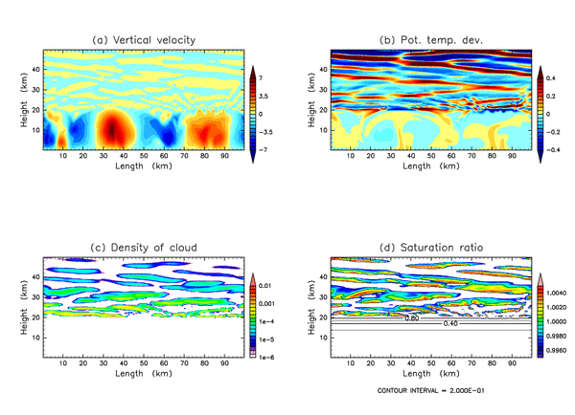
Circulation features and cloud distribution: Scr=1.0 （100 days)
Vertical velocity
Potential temperature
(km)
40
20
0
(km)
40
20
0
0 20 40 60 80 (km)
0 20 40 60 80 (km)
(km)
40
20
0
Cloud density
(km)
40
20
0
Saturation ratio
0 20 40 60 80 (km)
0 20 40 60 80 (km)
Notes:
細胞状の対流が定常的に存在

Slide 10
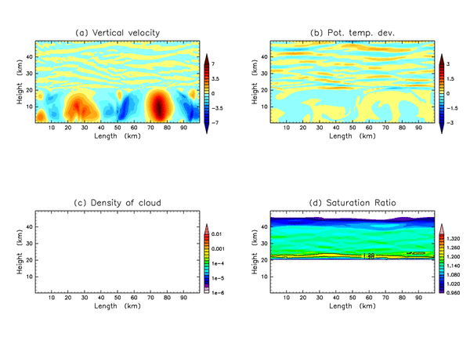
Circulation features and cloud distribution: Scr=1.35 (143 days)
Vertical velocity
Potential temperature
(km)
40
20
0
(km)
40
20
0
0 20 40 60 80 (km)
0 20 40 60 80 (km)
(km)
40
20
0
Cloud density
(km)
40
20
0
Saturation ratio
0 20 40 60 80 (km)
0 20 40 60 80 (km)
Notes:
凝結しない時期と凝結する時期が存在し, それぞれの時期の流れ場・雲密度の様相は大きく異なる.
そこで以下では先ず凝結しない時期(非凝結期)と凝結する時期(凝結期)の流れ場・雲密度の空間分布について述べる.

Slide 11
Concluding remarks
Circulation features and cloud distributions associated with condensation convection of CO₂ vary greatly with the values of Scr.
Scr=1.0: No supersaturation case
Condensation occurs continuously
Stratiform clouds is generated by gravity wave
Scr=1.35: Supersaturation case
Non-condensation and condensation periods occur alternately
In condensation periods, convective clouds forms
In non-condensation periods, clouds almost drops out

Slide 12
Appendices

Slide 13
Governing equations
Quasi-compressible equations(Klemp and Wilhelmson, 1978) and conservation equation for CO2 ice
Momentum equation:
Pressure equation:
Thermodynamic equation:
Conservation equation for CO2 ice:
Condensation/evaporation term

Slide 14
CO₂ ice cloud microphysics
Condensation/Evaporation rate (Tobie et al., 2003)
For 1<S<Scr, condensation does not occur if cloud density is less than a threshold value
We assume the value of threshold as 1.0e-6 kg/m³
Gravitational settling rate
$$M_{cond}=\frac{4πrρN_{∗}kRθ^{2}Π^{2}}{L^{2}}(S−1)$$
$$M_{fall}=\frac{∂}{∂z}\left(ρ_{s}V_{term}\right)$$
$$V_{term}=\left(1+\frac{4}{3}K_{n}\right)\frac{2r^{2}gρ_{I}}{9η}$$

Slide 15
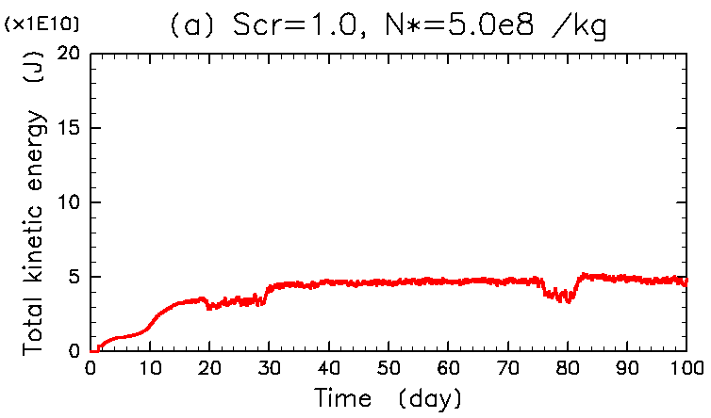
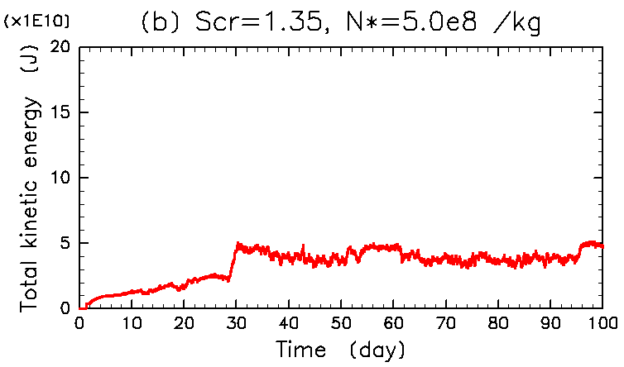
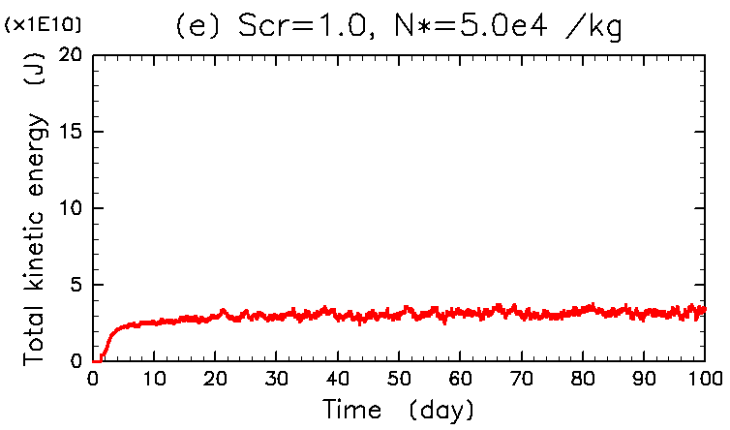
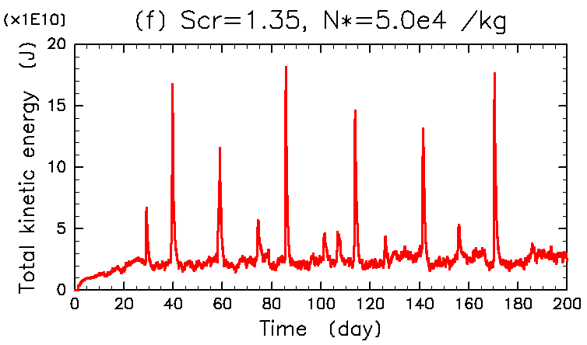
Total kinetic energy
Large
N*
Notes:
Scr, N* によって様相が大きく変わる
ほぼ一定 or 周期的変動のピーク値が一定 => 統計的平衡状態が実現

Slide 16
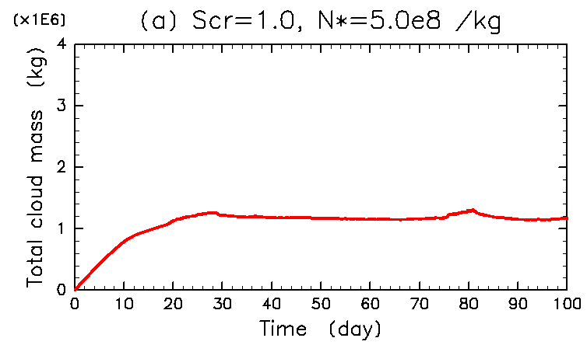
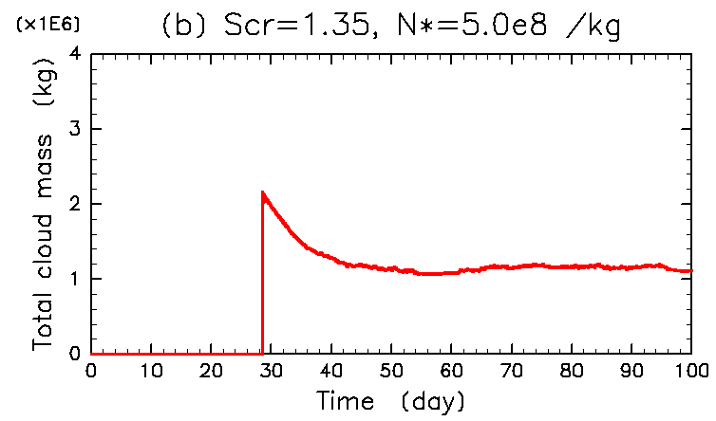
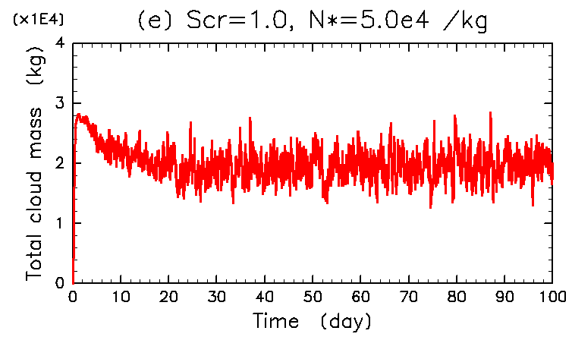
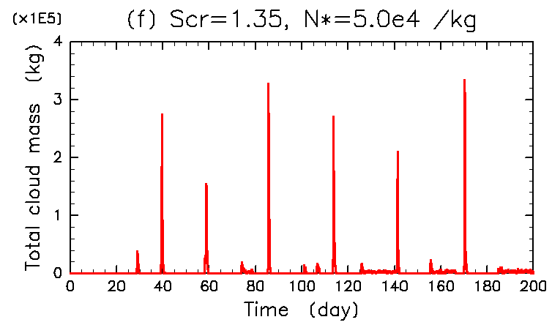
Total cloud mass
Large
N*

Slide 17
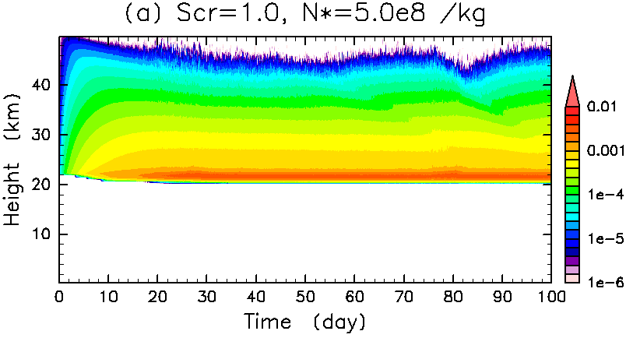
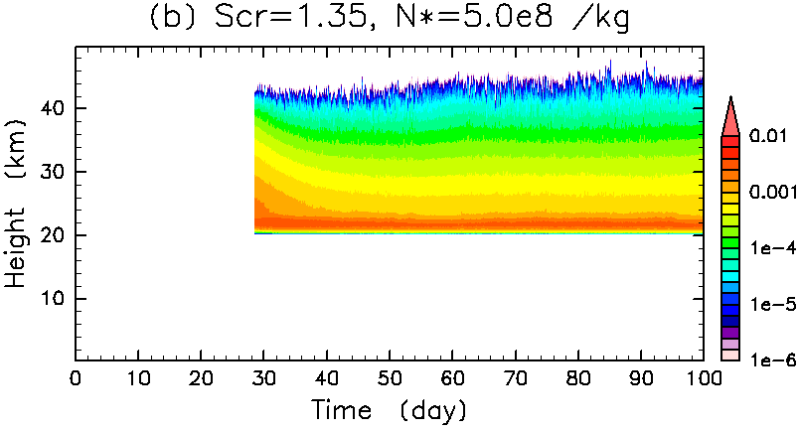
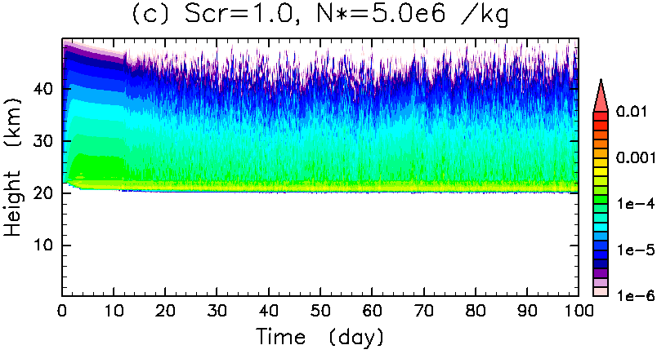
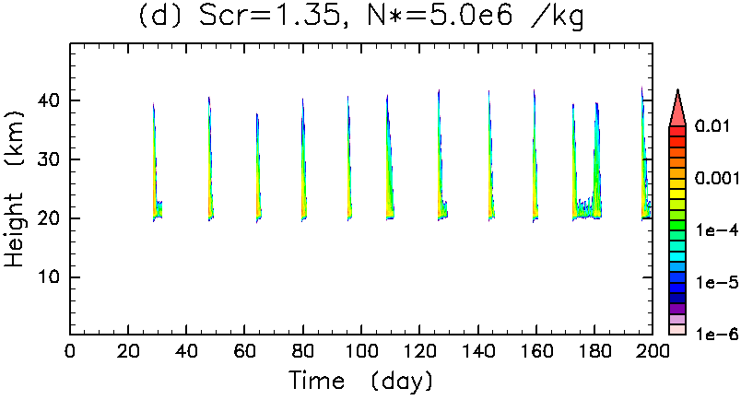
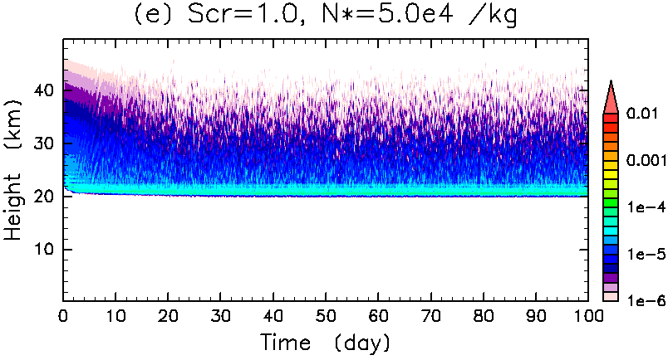
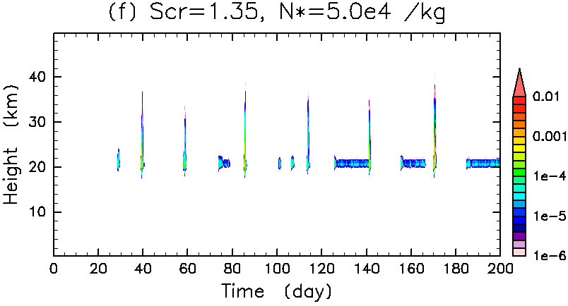
Horizontal mean cloud distribution
Large
N*
Notes:
準定常解: 雲分布が時間的に大きく変化しない
準周期解: 雲分布が周期的に変動し, 凝結期と非凝結期が交互に現れる

Slide 18
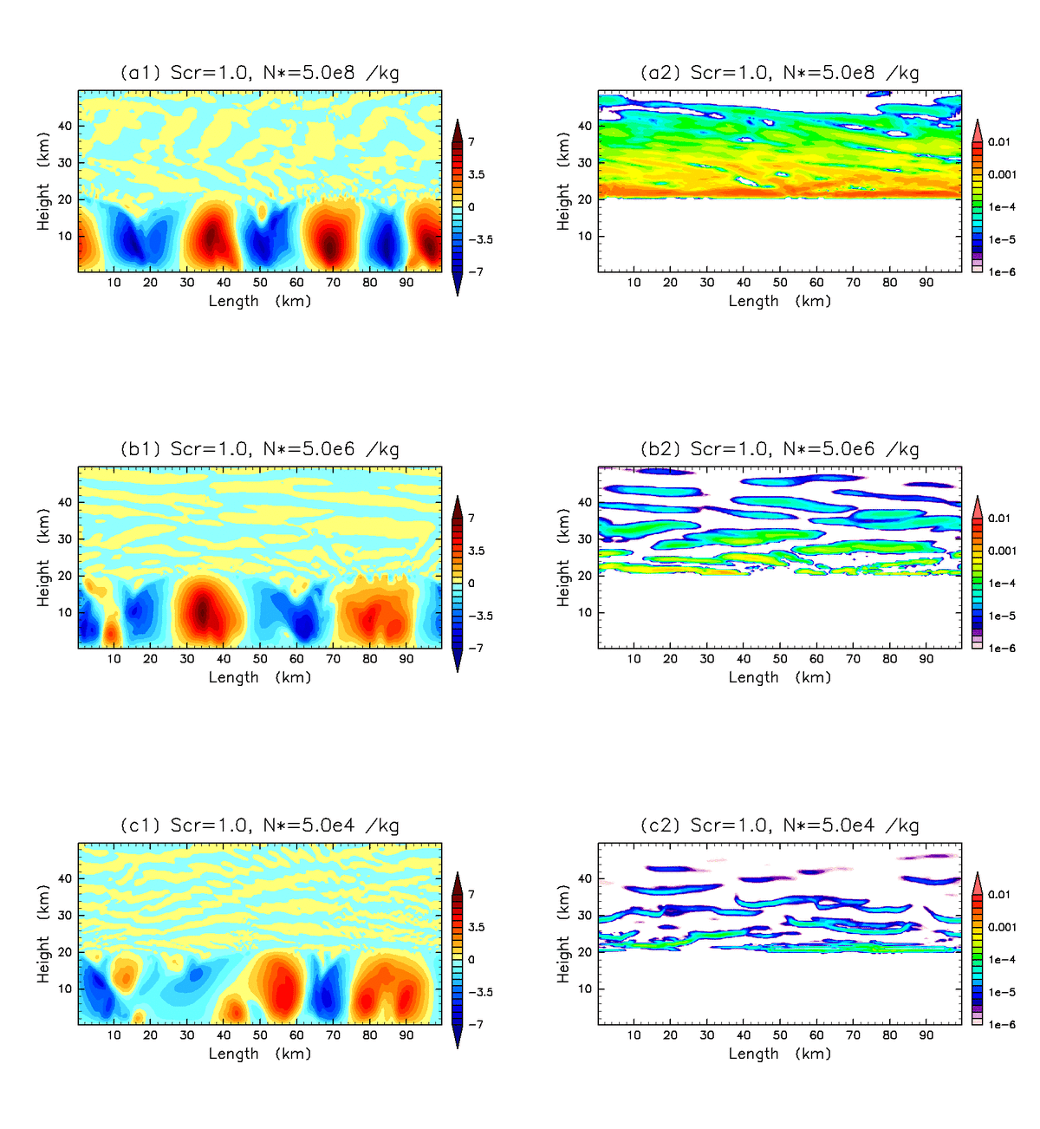
Dependency of number density of condensation nuclei: Scr=1.0
Large
N*
Small
Notes:
N*を変えても鉛直流の基本的な構造は変わらない
一方雲密度については, N*が小さくなるにつれて雲が占める面積が減少

Slide 19
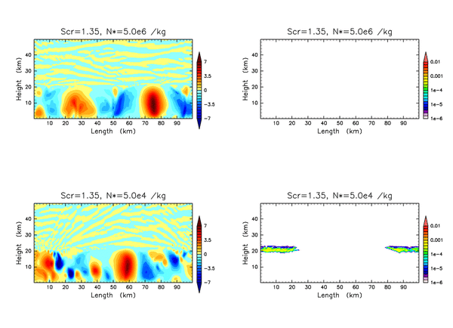
Dependency of number density of condensation nuclei: Scr=1.35
Large
N*
Small
Notes:
それぞれのN*の値に対する凝結期の動画
N*が変わると流れ場・雲密度の特徴は大きく異なる

