Slide 1
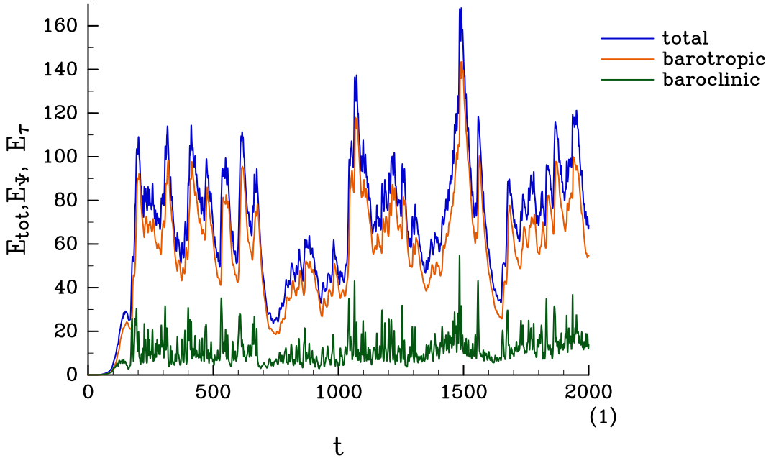



$${256}^{2}$$
$${512}^{2}$$
$${1024}^{2}$$

Slide 2
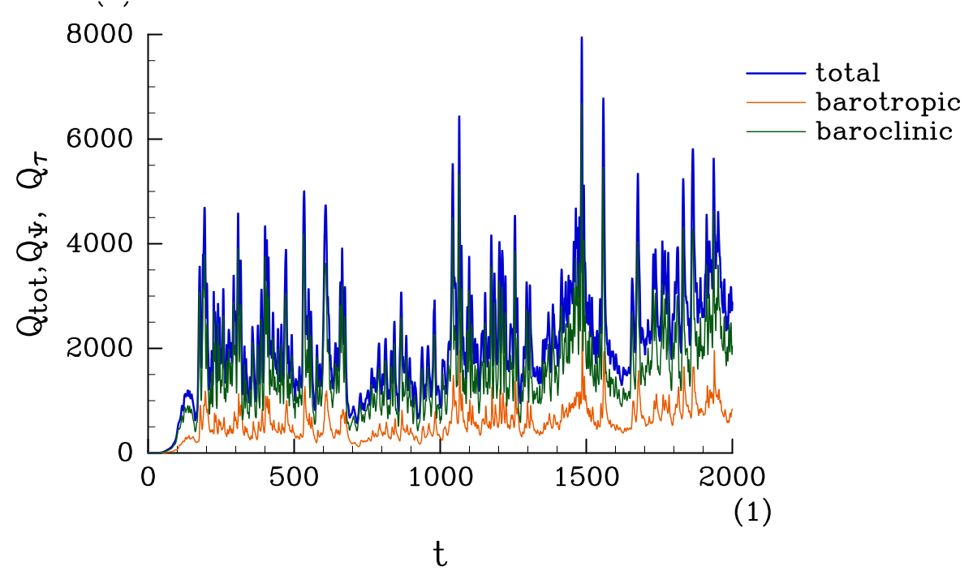

$${256}^{2}$$
$${512}^{2}$$
$${1024}^{2}$$

