Slide 1
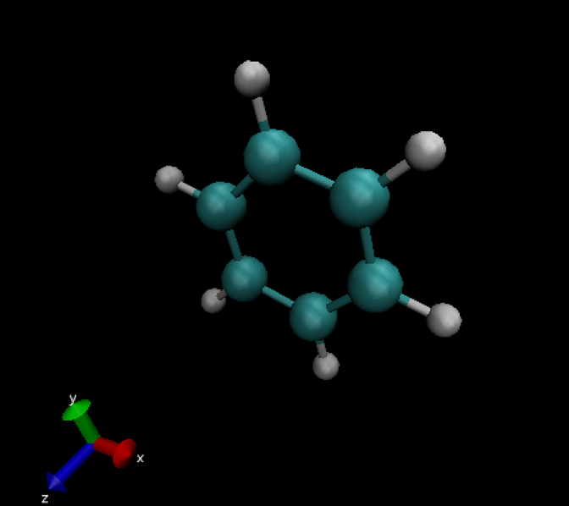
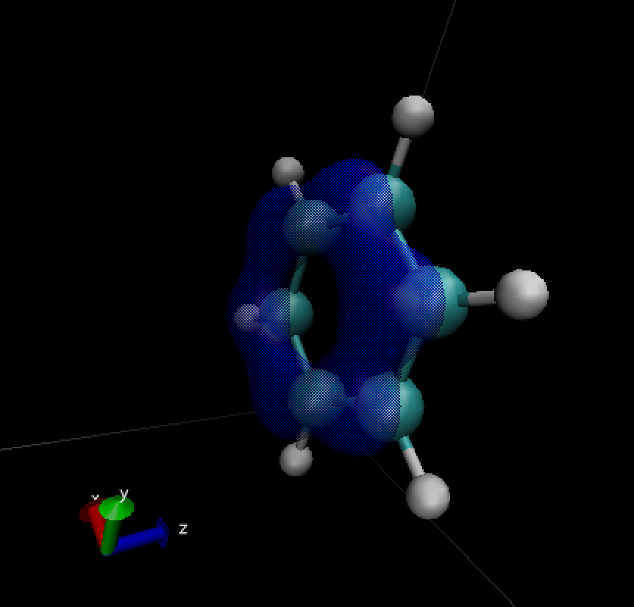
Density functional theory calculations of molecular orbital evolution during chemical reactions
Amanda Howard, Colin McSwiggen, Tianheng Chen, Akira Matsui

Slide 2
Outline
The problem: Molecular orbitals and DFT
Simulation methods
Results: Visualizing molecular orbital structures
Results: Visualizing chemical reactions
Conclusions

Slide 3
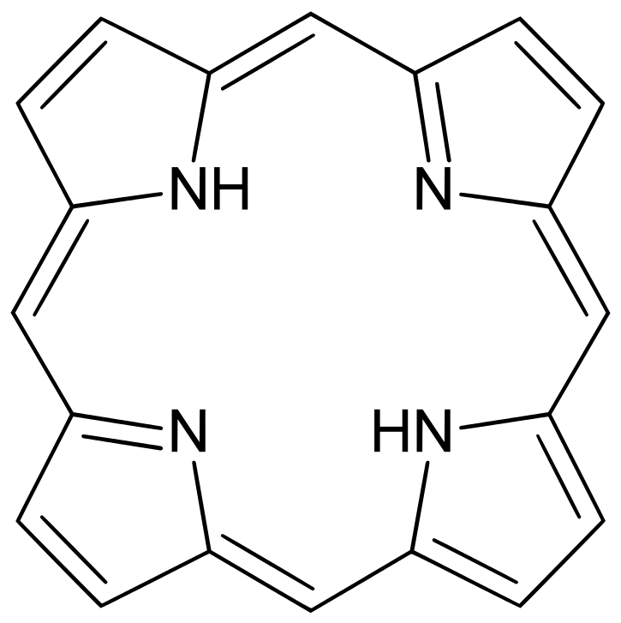
Goals
The calculation and visualization of molecular orbitals and their transformation during reactions.
We modeled molecular structures and chemical reactions to learn about the behavior of valence electrons.
Studied orbitals of porphyrin and reactions of smaller molecules.
Ultimately we want a better understanding
of what really goes on in chemical
reactions! This involves exploring a large
solution space, so is well-suited for HPC.

Slide 4



How do we model it?
The ASE (Atomic Simulation Environment) and Projector Augmented Wave (GPAW) Python packages for calculating orbitals and molecular geometries
Visual Molecular Dynamics (VMD) for visualization
Avogadro (molecule editor) for modeling molecules

Slide 5


Density Functional Theory
Goal: Numerical approximation of physical properties of a many-body quantum system in its ground state.
All information about the state of the system is expressed in the wave function, which satisfies the Schrödinger equation:
We can rewrite the wave function as an expression in terms of the electron density:
Thus the electron density tells us everything about the system, but it is a function of a single three-vector and is much more tractable to approximate.
We make an initial guess for the density by assuming no interaction between electrons. Then we refine our guess by iteratively solving the Kohn-Sham equations:
Kohn-Sham gives orbitals
Orbitals give new density

Slide 6
Kohn-Sham equations
Variational principle:
Applying Lagrangian multipliers:
Two main difficulties:
1. Last two terms depend on ρ, iteration needed
→ Self-consistent field (SCF) procedure
2. No explicit form of exchange-correlation term
→ Approximations (LDA, PBE, RPBE etc.)

Slide 7
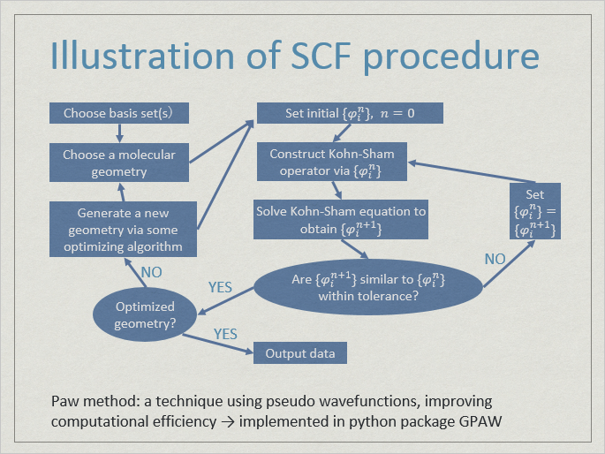
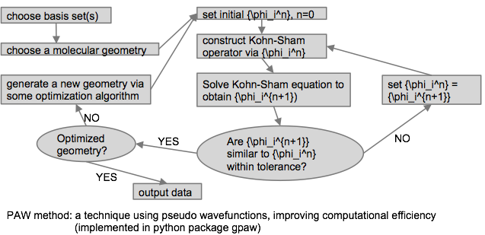
Flow chart of SCF procedure

Slide 8
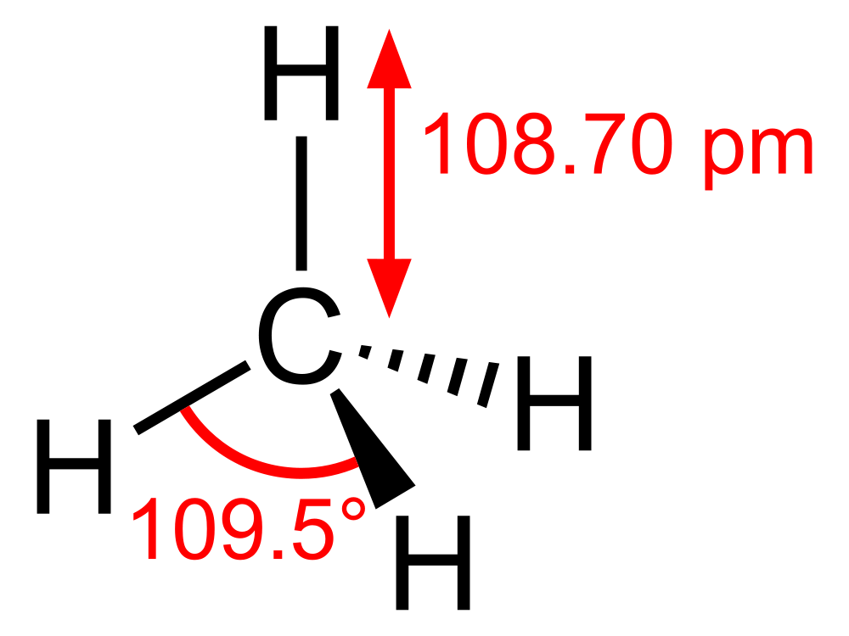
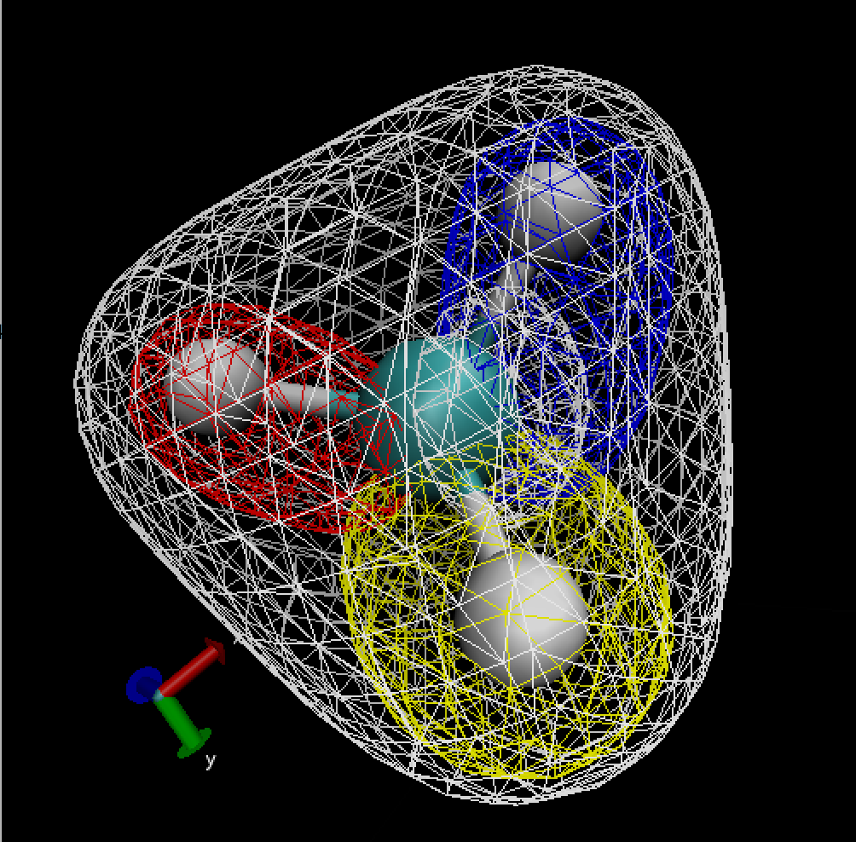
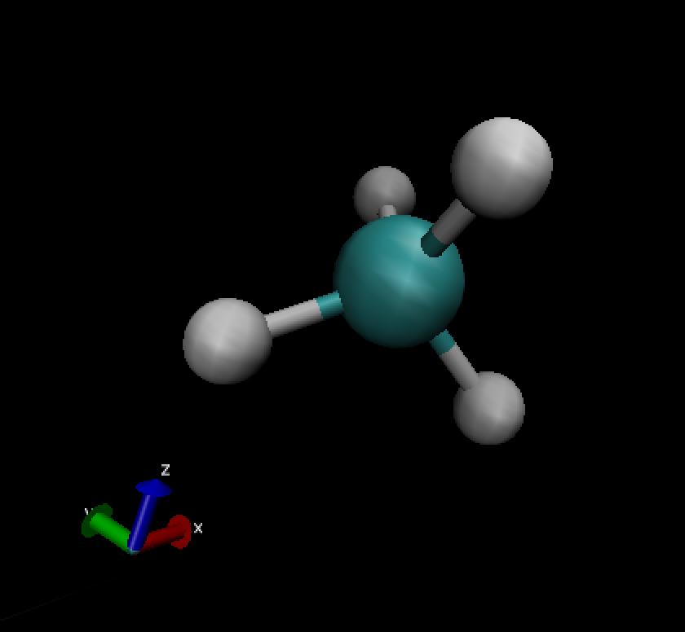
Results for small molecules
Example of small molecule: CH4, Methane
Visualization of orbitals shows how tetrahedral structure is formed

Slide 9
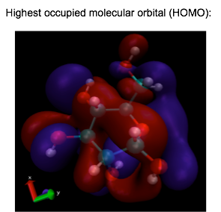
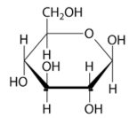
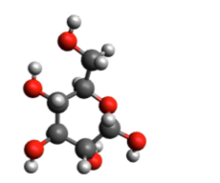
Results for bigger molecules
──Glucose

Slide 10
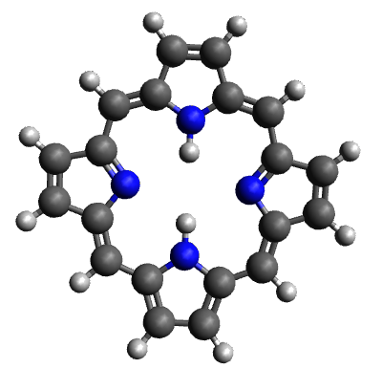
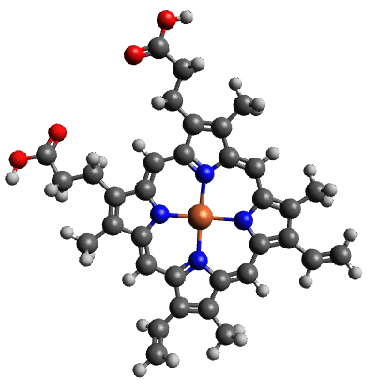

Results for bigger molecules
──Porphin and Heme
Fe
Side chains
Iron atom makes a big difference!
Every SCF step takes long time.
Geometry can not meet optimization criterion.

Slide 11
Experiment:
Modeling chemical reactions
Can we learn about the dynamics of chemical reactions by visualizing the transformation of valence electron orbitals?
Simulation setup: Atoms approach each other from a distance and react to form a compound. Compute and visualize valence orbitals at each time step.
Even for simple molecules, this is a very resource-intensive computational problem!

Slide 12
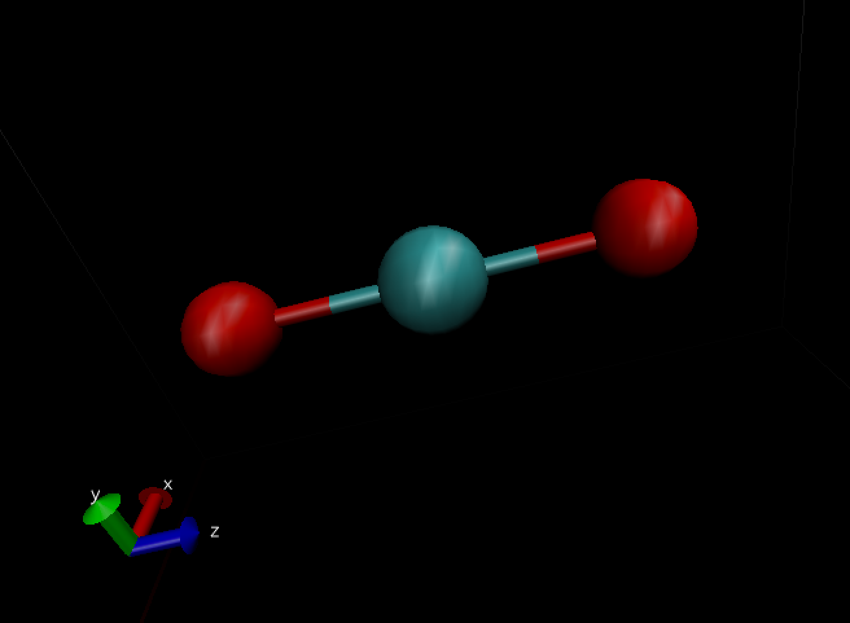
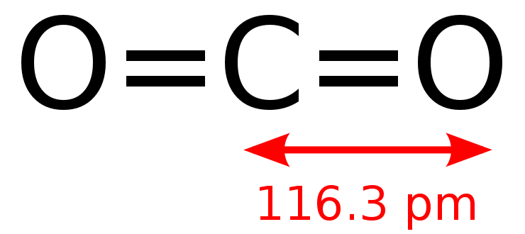
Experiment of small molecules reaction
Example of small molecule: CO2, Carbon dioxide
Visualizing what will happen when distort molecule position
Video shows how the molecule go to optimal position(stable position).

Slide 13
Videos!

Slide 14
Conclusions
DFT and existing tools work well for investigating properties of static molecules.
Dynamics stretch these techniques beyond their original purposes. It’s a promising direction, but the tools impose some limitations.
- Black-box objects make solver code difficult to optimize.
- Existing python modules not designed for parallelization
over time steps, have questionable memory management.
- Video animation requires a lot of hacking.
For further development, could either use more compute resources or write a new solver designed for dynamics.

